Slide 1
INTELEYE: Smart Surveillance for Weapon & Criminal Detection
Batch No:12
Supervisor: Dr.Annrose J, M.E., Ph.D.
By,
Dani Priya E (962222205016)
Mary Nirmala A (962222205033)
Medolin Christiyana J (962222205036)
Sherin Rickshiya A (962222205053)

Slide 2
ABSTRACT
Rising security challenges demand intelligent surveillance systems capable of real-time threat detection.
An AI-based surveillance framework is proposed to identify weapons and recognize known criminals from live video streams.
The system leverages YOLOv8 for weapon detection and DeepFace for face recognition, integrated through a web-based monitoring platform.
The approach aims to support faster decision-making and improved public safety in high-risk environments.

Slide 3
OBJECTIVE
To Develop a real-time weapon detection model.
To Implement a facial recognition system for criminal identification.
To Integrate detection models with live camera feeds.
ToDesign a centralized web interface for monitoring and alerts.
To Improve surveillance efficiency and reduce manual workload.

Slide 4
PROBLEM STATEMENT
Manual CCTV monitoring leads to human error and fatigue.
Traditional systems lack automated threat detection capabilities.
Identifying weapons and criminals in crowded environments is difficult.
Delayed response increases security risks.
An intelligent, automated surveillance solution is required.

Slide 5
HARDWARE & SOFTWARE REQUIREMENTS
Hardware Requirements
USB Camera
Computer System (Laptop/Desktop)
Minimum 8 GB RAM
Processor: Intel i5 or higher / Equivalent
Optional: GPU (for faster processing)
Software Requirements
Operating System: Windows / Linux
Programming Language: Python
Deep Learning Framework: PyTorch
Libraries: YOLOv8, DeepFace, OpenCV
Web Framework: Flask
Development Environment: VS Code / Jupyter Notebook

Slide 6
PROPOSED SYSTEM
An AI-based surveillance framework designed for continuous real-time monitoring.
Captures live video streams from CCTV or USB cameras for analysis.
Utilizes YOLO for accurate weapon detection in video frames.
Performs facial recognition by comparing detected faces with a criminal database.
Generates instant alerts and notifications when a threat is identified.
Displays detection results through a centralized web-based monitoring dashboard.

Slide 7
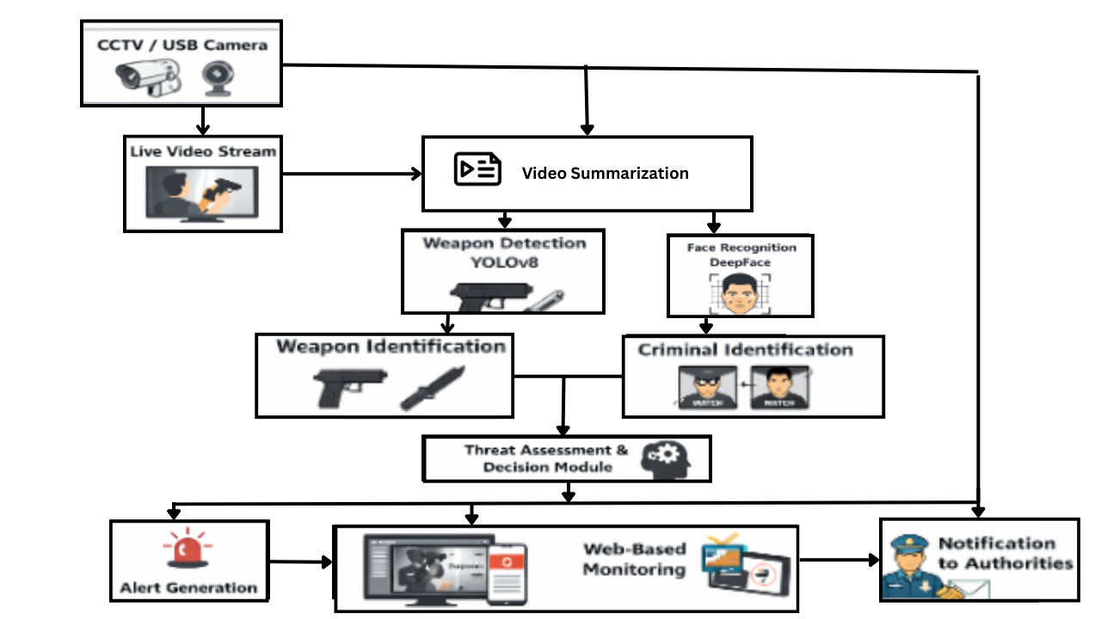
ARCHITECTURAL DESIGN

Slide 8
IMPLEMENTATION MODULES
Main Modules
Video Acquisition Module
Weapon Detection Module (YOLOv8)
Face Recognition Module (DeepFace)
Threat Assessment Module
Web Interface & Alert Module

Slide 9

SAMPLE OUTPUT
Figure 1:Home page – AI Surveillance System

Slide 10

SAMPLE OUTPUT
Figure 2:User Registration Interface

Slide 11

SAMPLE OUTPUT
Figure 3:User Login Interface

Slide 12

SAMPLE OUTPUT
Figure 4:Admin Login Interface

Slide 13
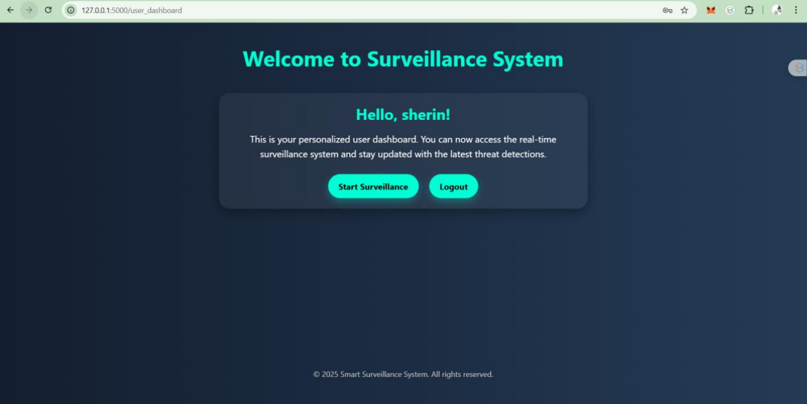
SAMPLE OUTPUT
Figure 5:Dashboard Interface

Slide 14
CONCLUSION
An AI-based intelligent surveillance framework has been designed for real-time weapon detection and criminal identification.
Deep learning models such as YOLOv8 and DeepFace enable automated threat analysis from live video streams.
The integrated system supports proactive monitoring and assists security personnel in faster decision-making.
The proposed approach contributes toward smarter, technology-driven public safety solutions.

Slide 15
REFERENCES
[1] S. B. Veesam and A. R. Satish, “Design of an Integrated Model for Video Summarization
Using Multimodal Fusion and YOLO for Crime Scene Analysis,” IEEE Access, vol. 13, pp.
25008–25025, 2025, doi: 10.1109/ACCESS.2025.3538282.
[2] S. B. Veesam and A. R. Satish, “Artificial intelligence powered crime scene analysis
service,” IEEE Access, 2025, doi: 10.1016/j.cviu.2020.102902.
[3] F. Schroff, D. Kalenichenko, and J. Philbin, “FaceNet: A unified embedding for face
recognition and clustering,” IEEE Transactions on Pattern Analysis and Machine Intelligence,
vol. 38, no. 2, pp. 815–830, Feb. 2022, doi: 10.1109/TPAMI.2015.2485557.
[4] Q. Wang and W. Deng, “Deep Face Recognition: A Survey,” ACM Computing Surveys, vol.
51, no. 3, Art. no. 65, 2023, doi: 10.1145/3193005.

Slide 16
REFERENCES
[5] Z. Zou, Z. Shi, Y. Guo, and J. Ye, “Object Detection in 20 Years: A Survey,” IEEE
Transactions on Pattern Analysis and Machine Intelligence, vol. 43, no. 5, pp. 1667–1687, May
2021, doi: 10.1109/TPAMI.2019.2940533.
[6] T.-Y. Lin et al., “Focal Loss for Dense Object Detection,” IEEE Transactions on Pattern
Analysis and Machine Intelligence, vol. 42, no. 2, pp. 318–327, Feb. 2020, doi:
10.1109/TPAMI.2018.2858826.
[7] R. Girshick, “Fast R-CNN,” IEEE Transactions on Pattern Analysis and Machine
Intelligence, vol. 39, no. 6, pp. 1137–1149, June 2023, doi: 10.1109/TPAMI.2016.2577031.
[8] S. Ren, K. He, R. Girshick, and J. Sun, “Faster R-CNN: Towards Real-Time Object
Detection With Region Proposal Networks,” IEEE Transactions on Pattern Analysis and
Machine Intelligence, vol. 39, no. 6, pp. 1137–1149, June 2024, doi:
10.1109/TPAMI.2016.2577031.

Slide 17
REFERENCES
[9] J. Redmon and A. Farhadi, “YOLOv3: An Incremental Improvement,” Computer Vision and
Image Understanding, vol. 192, Art. no. 102902, 2020, doi: 10.1016/j.cviu.2020.102902.
[10] A. Brunetti, D. Buongiorno, G. F. Trotta, and V. Bevilacqua, “Computer vision and deep
learning techniques for pedestrian detection and tracking: A survey,” Neurocomputing, vol. 300,
pp. 17–33, July 2023, doi: 10.1016/j.neucom.2018.01.092.
[11] W. Liu et al., “SSD: Single Shot MultiBox Detector,” IEEE Transactions on Pattern
Analysis and Machine Intelligence, vol. 40, no. 6, pp. 1263–1275, June 2024, doi:
10.1109/TPAMI.2017.2737030.
[12] J. Deng et al., “ImageNet: A Large-Scale Hierarchical Image Database,” International
Journal of Computer Vision, vol. 115, no. 3, pp. 211–252, Dec. 2025, doi: 10.1007/s11263-015-
0816-y.

Slide 18
REFERENCES
[13] G. Wang et al., “Fighting against terrorism: A real-time CCTV autonomous weapons
detection based on improved YOLO v4,” Digital Signal Processing, vol. 132, Art. no. 103790,
Jan. 2023, doi: 10.1016/j.dsp.2022.103790.
[14] T. Santos et al., “Systematic review on weapon detection in surveillance footage through
deep learning,” Computer Science Review, vol. 51, Art. no. 100612, 2024, doi:
10.1016/j.cosrev.2023.100612.
[15] D. Berardini, L. Migliorelli, A. Galdelli, and M. J. Marín-Jiménez, “Edge artificial
intelligence and super-resolution for enhanced weapon detection in video surveillance,”
Engineering Applications of Artificial Intelligence, vol. 140, Art. no. 109684, Jan. 2025, doi:
10.1016/j.engappai.2024.109684.
[16] H. Choi et al., “Deep Learning-Based Real-Time Object Detection for Surveillance
Applications,” IEEE Access, vol. 9, pp. 70940–70952, 2021,
doi:10.1109/ACCESS.2021.3078891.

Slide 19
REFERENCES
[17] J. Connan et al., “Real-Time Gun and Person Detection for Smart Surveillance,” ACM
Transactions on Multimedia Computing, Communications, and Applications, 2025, doi:
10.1145/3759023.3759128.
[18] K. He, X. Zhang, S. Ren, and J. Sun, “Deep Residual Learning for Image Recognition,”
IEEE Transactions on Pattern Analysis and Machine Intelligence, vol. 40, no. 4, pp. 843–856,
Apr. 2024, doi: 10.1109/TPAMI.2016.2577031.
[19] A. Krizhevsky, I. Sutskever, and G. E. Hinton, “ImageNet Classification with Deep
Convolutional Neural Networks,” Communications of the ACM, vol. 60, no. 6, pp. 84–90, June
2017, doi: 10.1145/3065386. (Publisher: ACM)
[20] W. Zhao, R. Chellappa, P. J. Phillips, and A. Rosenfeld, “Face Recognition: A Literature
Survey,” Pattern Recognition, vol. 35, no. 4, pp. 399–458, Apr. , doi: 10.1016/S0031-
3203(01)00092-5. (Publisher: Elsevier / ScienceDirect)

Slide 20
THANK YOU

